Slide 1
SPHERE-PPL Annual Meeting & Workshop
Health Modelling & Forecasting
SPHERE-PPL Team
Thursday 23rd January 2025

Slide 2
Welcome!

Slide 3
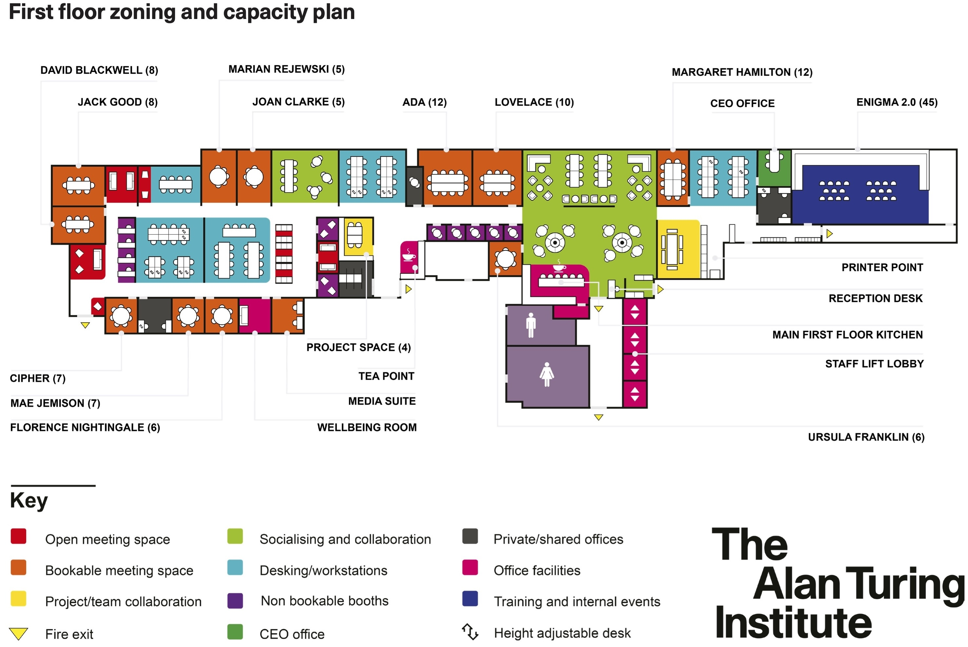
Facilities & Accessibility

Slide 4
WiFi
Network: Turing Guest
Password: clicking seventh void compiled
(Password contains spaces)

Slide 5
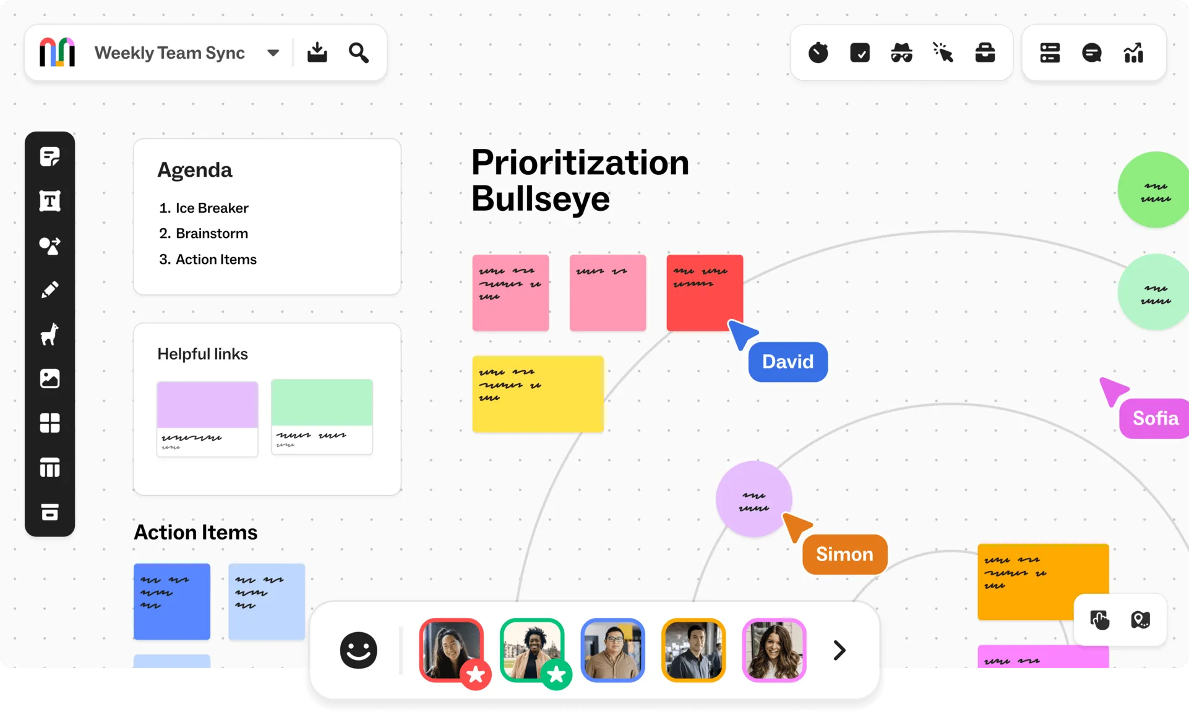
Mural
We will be using Mural for all the activities: https://shorturl.at/QOSEy
Password: forecast
(No need to create an account)

Slide 6
Code of Conduct
Respectful Communication: Communicate with others in a professional and considerate manner. Be mindful of diverse perspectives and experiences. Avoid interrupting others and listen actively.
Inclusive Language: Use inclusive language that avoids any discriminatory or offensive remarks. Be mindful of gender, race, ethnicity, religion, sexual orientation, and other personal attributes.
Active Participation: Engage actively in discussions and activities. Share your insights and perspectives while being mindful of others' contributions.
Professional Conduct: Maintain a professional demeanour throughout the workshop, including during breaks and social events.
Mobile Devices: Minimize distractions by silencing mobile phones or using them only during breaks, unless they are essential for workshop activities.

Slide 7
Agenda
Timings | Activity | Description
9:30-10:00 | Arrivals & Registration
10:00-10:15 | Introduction from the SPHERE-PPL Team | Meet the team and an introduction to the vision
10:15-10:40 | Keynote 1 - Dr Hannah Rose Vineer | tbc
10:40-11:00 | Keynote 2 - Dr Richard Wood | Insights from Modelling & Analytics within the NHS
11:00-11:30 | Coffee Break
11:30-12:15 | Break-Out Discussion | Identifying key challenges in health policy
12:15-12:45 | Break-Out Feedback | 2-minute presentations on challenges
12:45-13:45 | Lunch

Slide 8
Agenda
Timings | Activity | Description
13:45-13:55 | Presentation | Building a Forecasting Contest
13:55-14:30 | Break-Out Design | Groups design forecasting contests
14:30-15:00 | Break-Out Feedback | Group feedback and discussion of contest priorities
15:00-15:30 | Coffee Break
15:30-15:40 | Presentation | What can SPHERE-PPL do for you?
15:40-16:00 | Break-Out Discussion | Brainstorming requests for workshops, training and support
16:00-16:30 | Break-Out Feedback | Creating a community priority list
16:30-17:00 | Wrap-Up

Slide 9
Introduction from the SPHERE-PPL Team

Slide 10
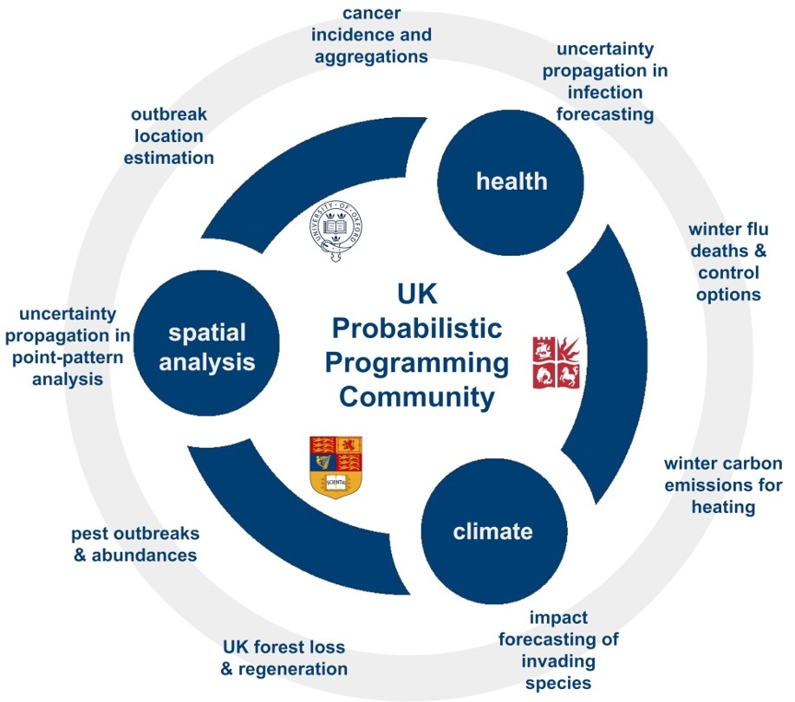
What is SPHERE-PPL?
SPatial, Health and Environmental Research using Probabilistic Programming Languages

Slide 11
Outcomes of the Day
This full-day event will bring together experts in a range of fields from industry, academia, and government to discuss cutting-edge research and explore collaborative opportunities within health.
Meeting participants will:
Network with policy specialists and data scientists to discuss issues through a common language
Identify forecasting challenges that the SPHERE-PPL Community will undertake and contribute to the design and outcomes of these endeavours to maximise their impact.
Prioritise the training and support provided by SPHERE-PPL to the community to expedite the development of analytical capabilities where they are most urgently required

Slide 12
Keynotes

Slide 13



Keynotes
 | Dr Hannah Rose Vineer – University of Liverpool & VBD Hub
 | Dr Will Pearse – The Alan Turing Institute & Imperial College London
 | Dr Richard Wood – BNSSG ICB & University of Bath

Slide 14
Coffee Break
Refreshments are around the corner in the kitchen areas

Slide 15
Activity 1 - Identifying Key Challenges in Health Policy

Slide 16
How its going to work!
https://shorturl.at/QOSEy
Stage 1 - Break-out Discussions (45 minutes)
Split into teams
45 minutes to talk about key challenges in Health Policy that relate to modelling & forecasting
Add them to the Mural Board
Don't worry about finding solutions, we will do that in this afternoon's session
Stage 2 - Group Feedback & Contest Priorities Vote (45 minutes)
Each team will have 2 minutes to present what they think is the biggest challenge they discussed
These will form the basis of our forecast contest discussions later!

Slide 17
Activity 1 – Group Feedback

Slide 18
Lunch Break
Refreshments and food are around the corner in the kitchen areas!

Slide 19
Welcome Back!
Timings | Activity | Description
13:30-14:15 | Break-Out Design | Groups design forecasting contests
14:15-15:00 | Break-Out Feedback | Group feedback and discussion of contest priorities
15:00-15:30 | Coffee Break
15:30-15:40 | Presentation - Dr Josh Tyler | What can SPHERE-PPL do for you?
15:40-16:00 | Break-Out Discussion | Brainstorming requests for workshops, training and support
16:00-16:30 | Break-Out Feedback | Creating a community priority list
16:30-17:00 | Wrap-Up

Slide 20
Activity 2 – Designing a Forecasting Contest

Slide 21
How its going to work!
Stage 1 – Building a Forecasting Contest (10 minutes)
Quick presentation from the SPHERE-PPL team on how the forecasting contests are going to work mechanically and what makes a good contest
Stage 2 – Break-Out Discussions (40 minutes)
Split into teams of 8
Using the Contest grids on the Mural Board, start designing a forecasting contest
Stage 3 - Group Feedback (40 minutes)
Each team will give an overview of their proposed contest
Indicative vote on what would provide greatest impact

Slide 22
Building a Forecasting Contest
From Questions to Insights
Dr Josh Tyler

Slide 23

Why do a Forecasting Contest?
Grand Vision
An open-source and globally-accessible competition to find innovative and accurate ways of predicting something.
A conduit for connecting stakeholders with analytical capability.
Smaller Scale
Find answers to the challenges we talked about earlier!
Put resources and insights into your hands.

Slide 24
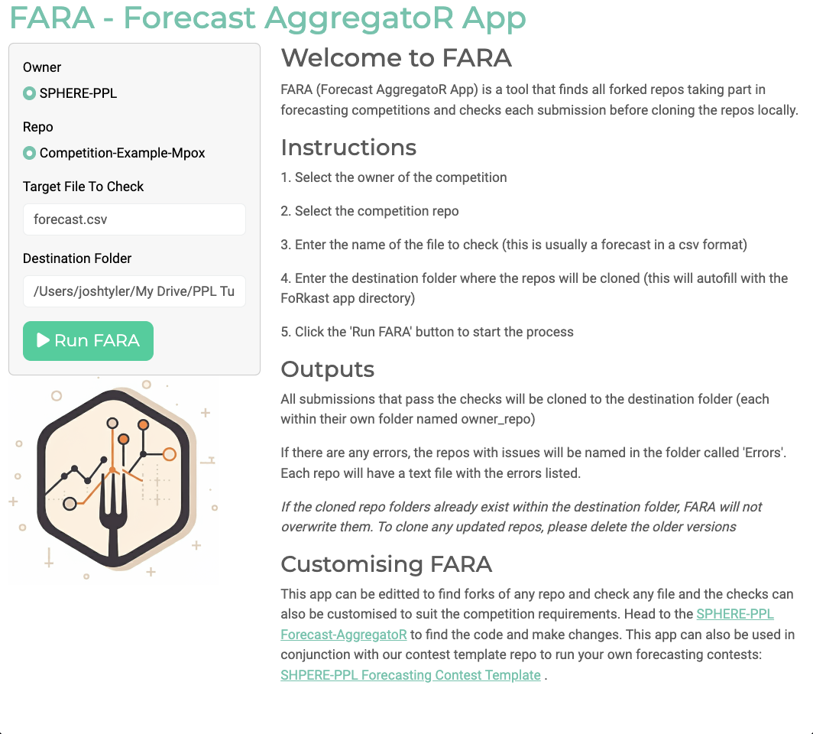
SPHERE-PPL Framework
A Github Repo, that can be cloned, edited and then collated by contest organisers, using our Forecasting AggregatoR App (FARA).
FARA can:
Find all contest submissions automatically
Check entries for errors and issues
Be customised for any GitHub-based contest
Condense all results and synthesise insights

Slide 25
Journey of a Contest
Design
Implementation
Participation
Aggregation
Insights

Slide 26
Considerations
Design What are the Key Challenges we want to solve?
Who will benefit from the forecasts?
Implementation What datasets can we use openly? Are there any specific strategies or tools that we want to see?
Participation Can we engage with a diverse set of teams? Do they have enough time? How can we best support them?
Aggregation How should we aggregate all the entries? Do we want to build a new model based on the findings of the contest?
Insights What format would create the most impact? How can we disseminate the results and maximise usefulness?

Slide 27
Maximising Value to Stakeholders
Forecast Contests
New Tools & Techniques
Novel Insights
Growth & Improvement
New Questions

Slide 28

Example - CVDs
Key Challenge | Future burden of Cardiovascular Disease (CVD)
Exam Question | Forecast the number of new cases of CVD in the UK for each year from 2024 to 2034, stratified by age group and sex.
Usable Data | PHE Data (Trends in CVD mortality, morbidity, and risk factors ONS Data (population projections, mortality rate, socioeconomic factors)
Output Format | Table of forecasted numbers Summary report Deployable app
Other Information | Include coronary heart disease, stroke, and heart failure

Slide 29
How its going to work!
https://shorturl.at/QOSEy
Stage 1 – Building a Forecasting Contest (10 minutes)
Quick presentation from the SPHERE-PPL team on how the forecasting contests are going to work mechanically and what makes a good contest
Stage 2 – Break-Out Discussions (40 minutes)
Split into teams of 8
Using the Contest grids on the Mural Board, start designing a forecasting contest
Stage 3 - Group Feedback (40 minutes)
Each team will give an overview of their proposed contest
Indicative vote on what would provide greatest impact

Slide 30
Key Challenges in Health & Policy

Slide 31
Activity 2 – Group Feedback

Slide 32
Coffee Break
Refreshments are around the corner in the kitchen areas

Slide 33
Activity 3 – Building a Community

Slide 34
How its going to work!
Stage 1 – What can SPHERE-PPL do for you? (10 minutes)
Quick presentation from the SPHERE-PPL team on what the future holds
Stage 2 – Brainstorming requests for workshops, training and support (20 minutes)
Split into groups and make a list of different ideas that would help you make progress in your area (added on the Mural Board)
Include as many details as possible!
Stage 3 – Creating a community priority list (30 minutes)
Each team will give an overview of their requests
Discussion around how the SPHERE-PPL community can best facilitate and maximise value

Slide 35
What can SPHERE-PPL do for you?
The network’s primary goal is to connect data-scientists, researchers and policy-makers, to enable high-quality modelling and data-driven decision-making.
The SPHERE-PPL project has funding to facilitate workshops, training and targeted support on both fundamental modelling & probabilistic programming, alongside events and sessions like today, working directly with stakeholders.

Slide 36
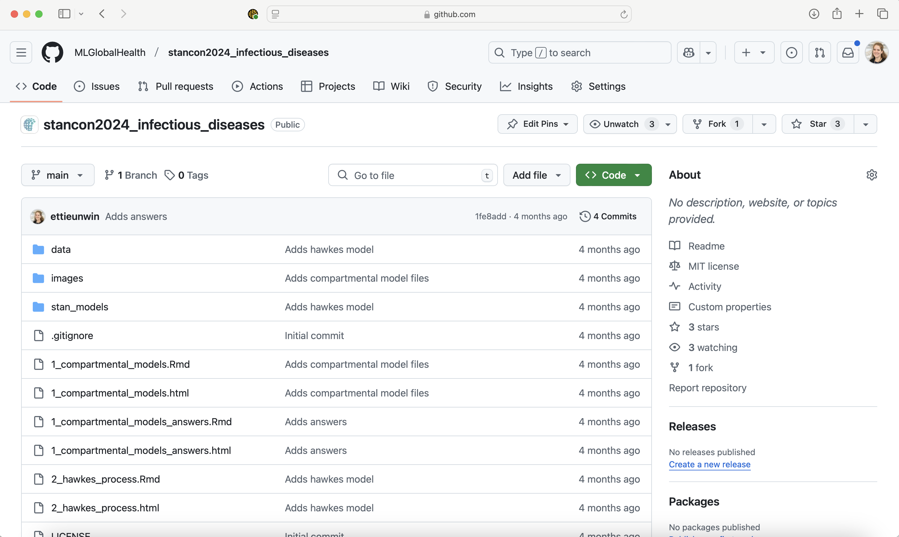
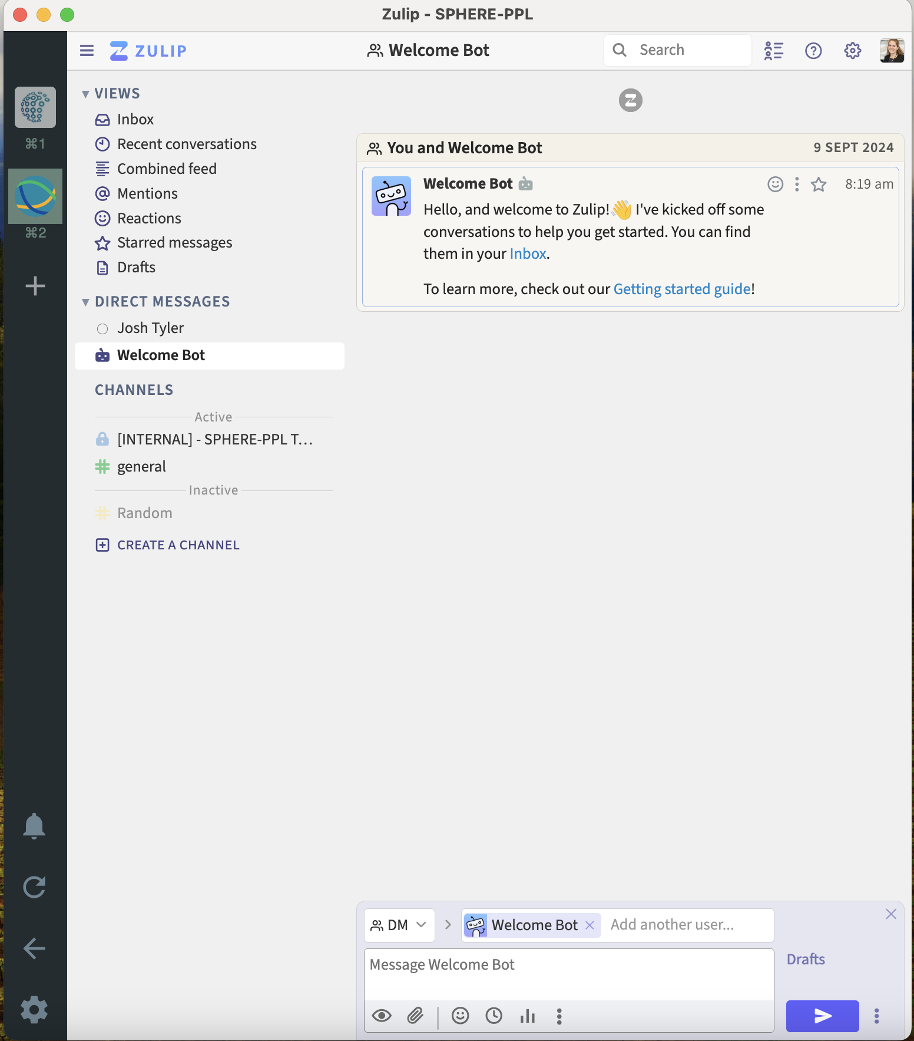
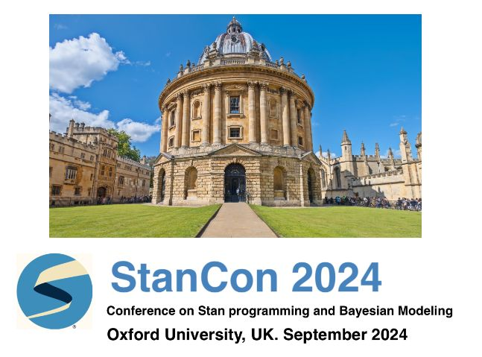
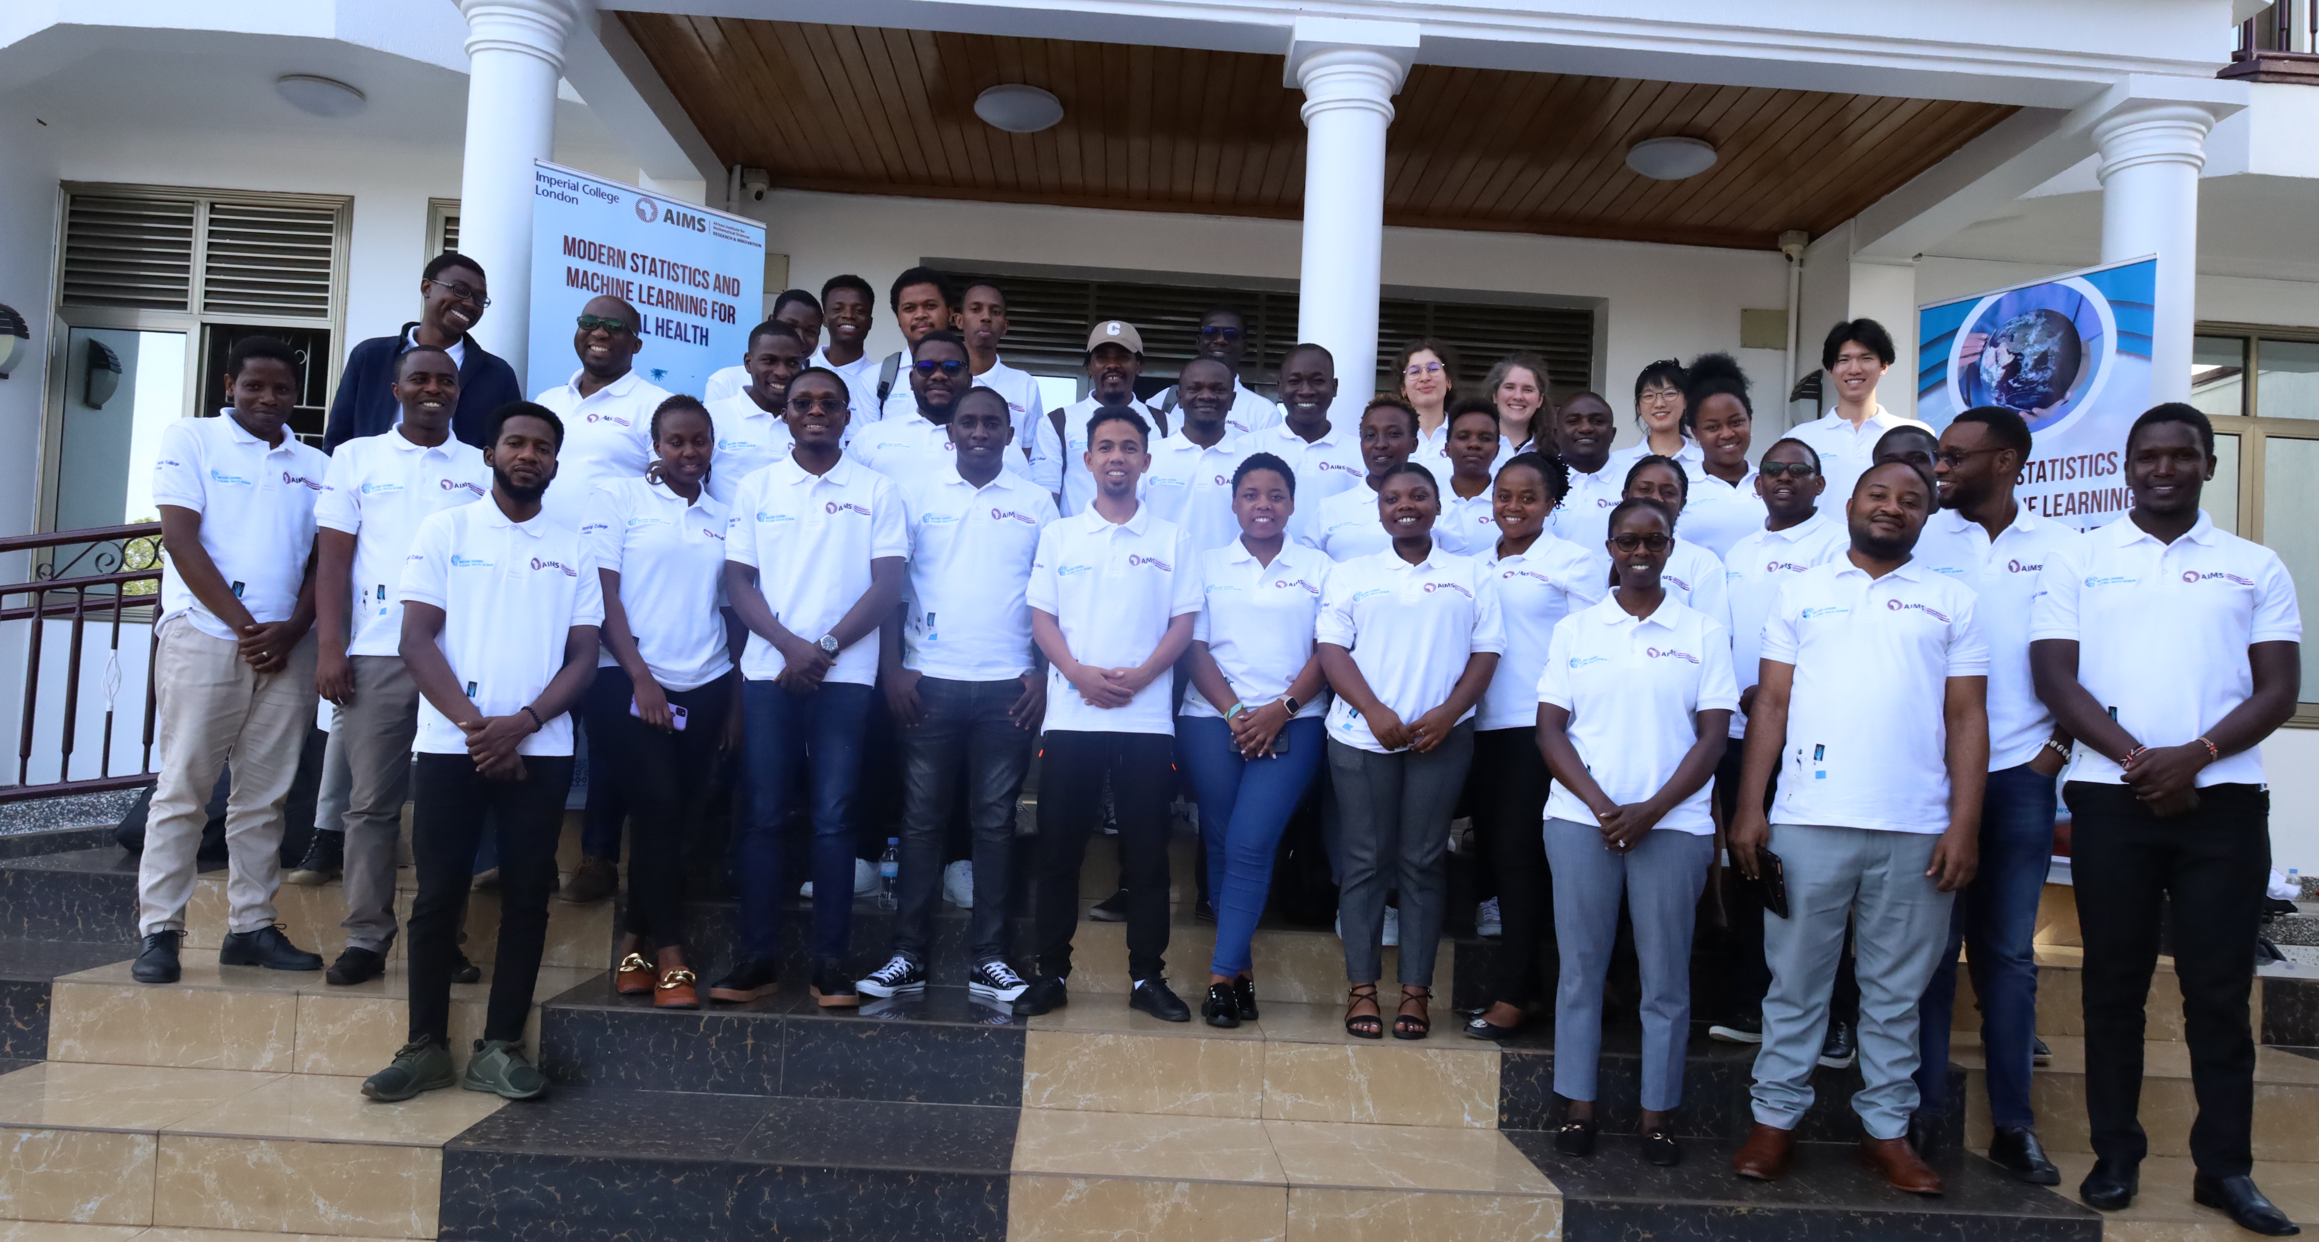
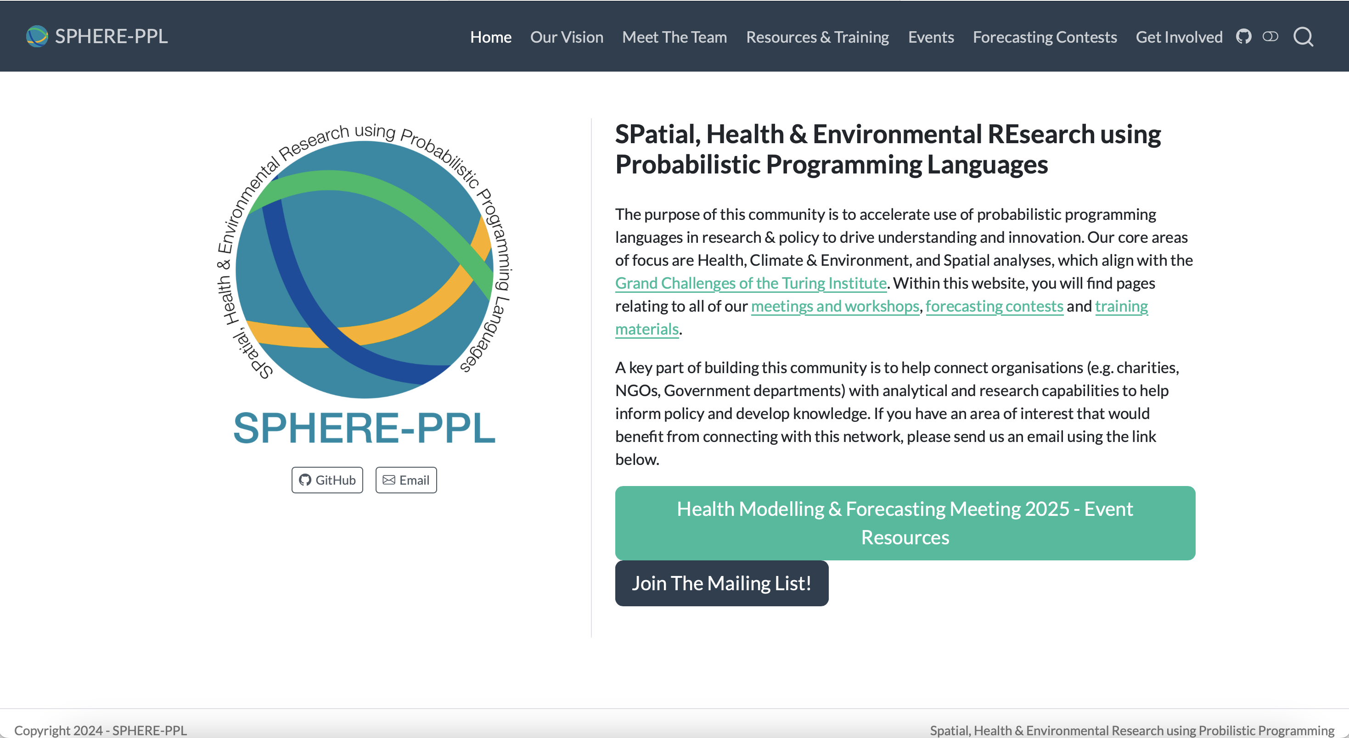
What we’ve done so far

Slide 37
How its going to work!
https://shorturl.at/QOSEy
Stage 1 – What can SPHERE-PPL do for you? (10 minutes)
Quick presentation from the SPHERE-PPL team on what the future holds
Stage 2 – Brainstorming requests for workshops, training and support (20 minutes)
Split into groups and make a list of different ideas that would help you make progress in your area (added on the Mural Board)
Include as many details as possible!
Stage 3 – Creating a community priority list (30 minutes)
Each team will give an overview of their requests
Discussion around how the SPHERE-PPL community can best facilitate and maximise value

Slide 38
Activity 3 – Priority List

Slide 39
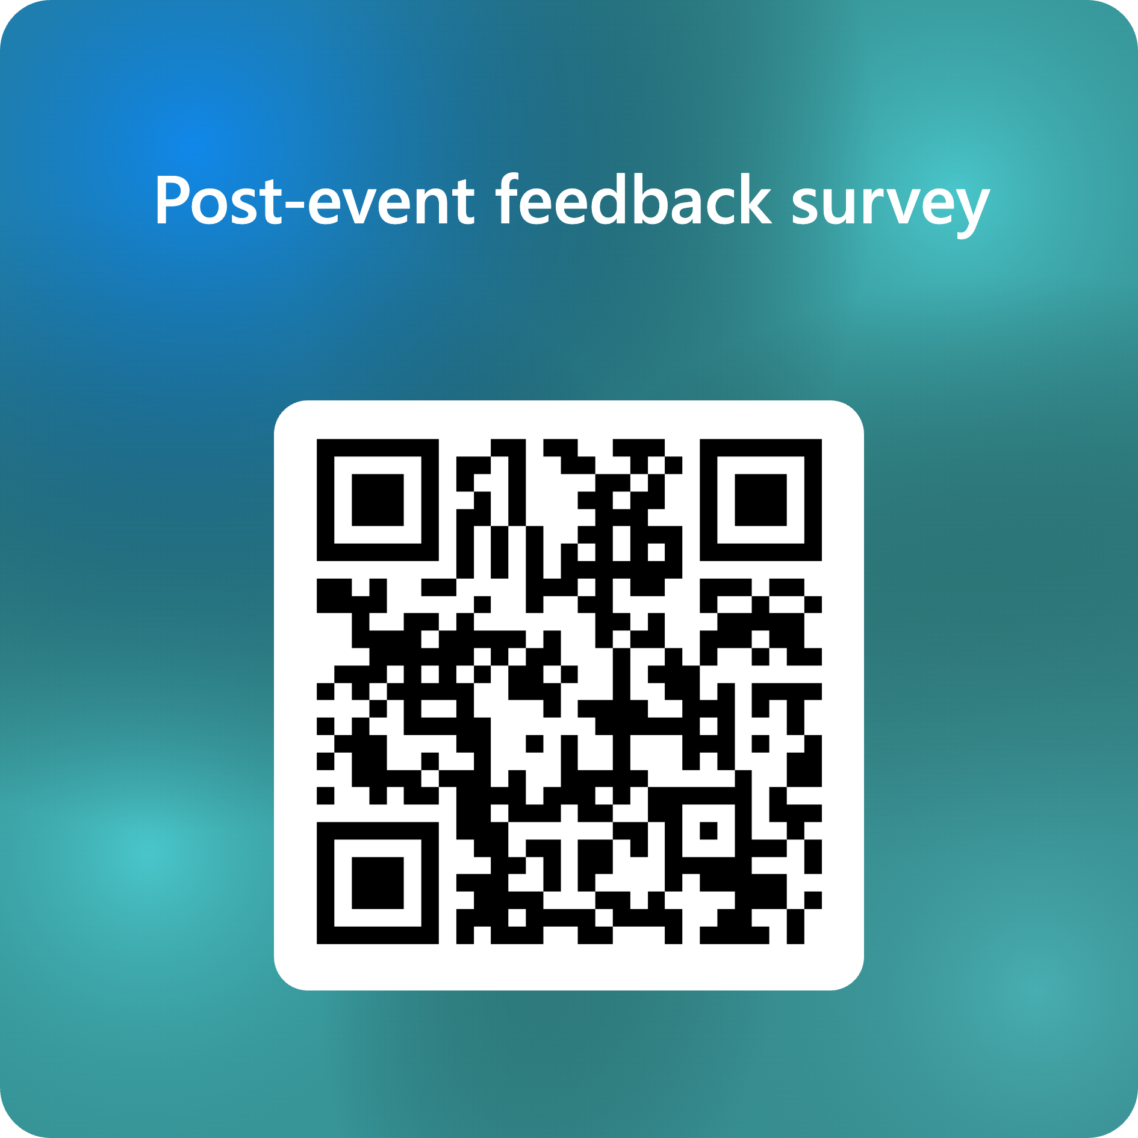
Wrap-Up
We’ve reached the end of the day!
Please complete the Feedback Survey!

Slide 40
Thank-You!
For more information, please visit www.sphere-ppl.org or email the team at info@sphere-ppl.org.

